Slide 1
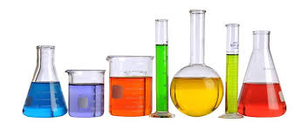
Stories for Science
Neural Gene Transfection
Guide to giving an interesting talk

Slide 2
Why Storytelling in Science?
Have you ever seen?
A Bad Talk?
A Bad Poster Presentation?
A Bad Class Lecture?
A Inaccurate News Report on Science?
A Popular Movie
that Misrepresented Scientific Information?

Slide 3
Why Does Style Matter?
Have you ever read?
A Bad Scientific Article?
The data may be very good… but…
The POINT of the research is hard to understand
The INTERPRETATION of the research is confusing
The LARGER PICTURE is missing
The Larger Picture is not cohesive
Inaccurate Scientific News?

Slide 4
Even More to the Point…
Have you ever Heard a Scientific Talk
That you COULD have Understood?… but…
The language used was so filled with JARGON
Language specific to a SINGLE LAB was used
Specific to a sub-field of investigation

Slide 5
Even More to the Point…
Have you ever Heard a Scientific Talk
That you COULD have Understood?… but…
“Sciencey” language replaced plain English
Satiate rather than Satisfy or Sate
Acclimatization vs Acclimation
There were Acronyms or Abbreviations
That were NOT defined
The Specific Aims were NOT Spelled Out
Hypotheses were NOT clear

Slide 6
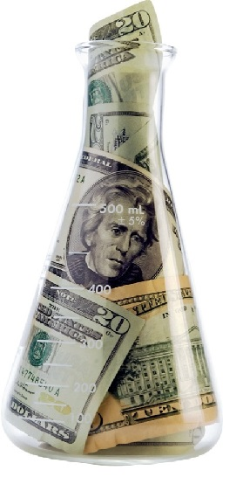
So What?
Ultimately our jobs in Science
Depends on PUBLIC support
If the value of our efforts is not widely understood
Less Public Approval of and Support for Science
Less Funding for Science
Reduced Funding for Universities

Slide 7
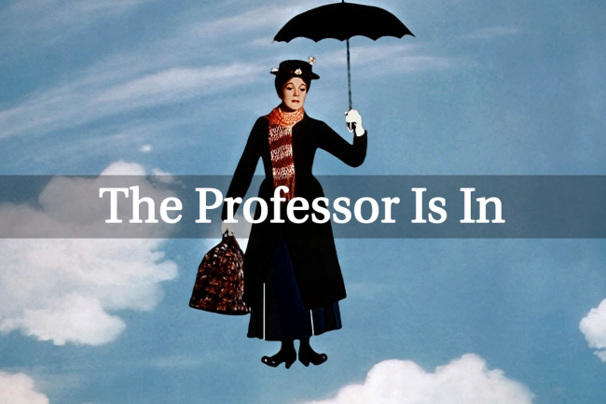
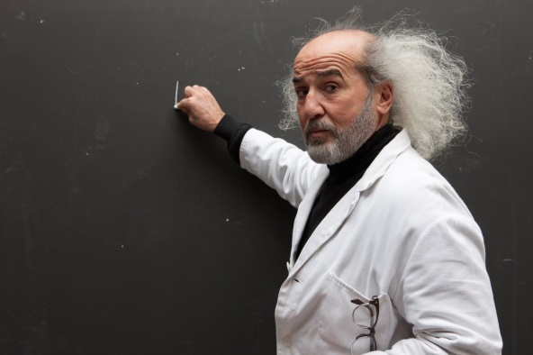
So What?
YOUR Future JOB
or Promotion
or FUNDING
Depends on Impressing (Future) Colleagues
And People are good at Smelling βڹ₤£§Ђ¡+

Slide 8
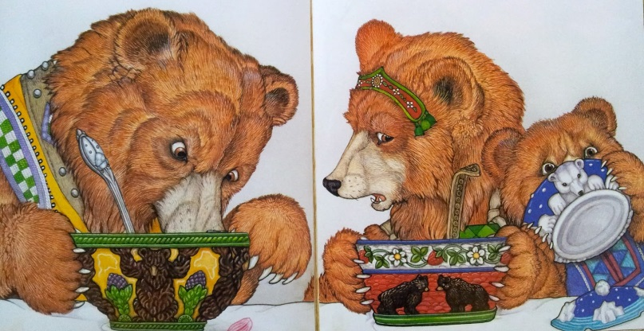
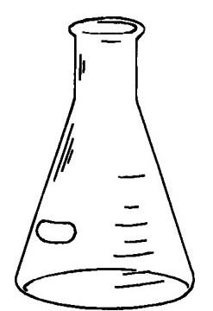
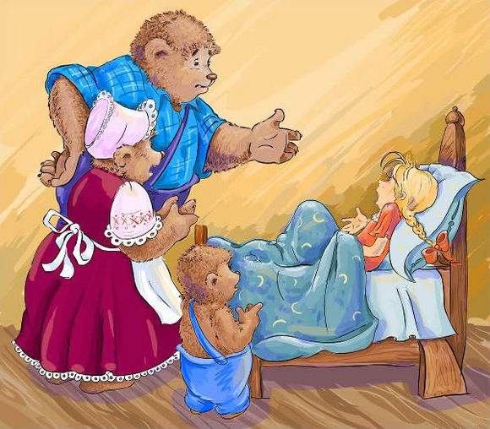
How to
Learn something from… Fiction
Tell A Story
Every Time we…
Write a Scientific Article, Grant Proposal, Review
Give a Talk
Give a Poster
Give an Interview
Give a Job Talk

Slide 9
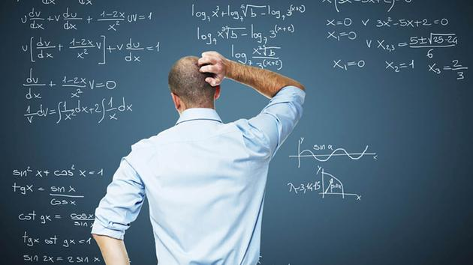
What Does it Mean to Tell a Story?
All Communications Need:
A defined Beginning, Middle, and End
A Linear Narrative
Logical Linear Progression of Ideas

Slide 10
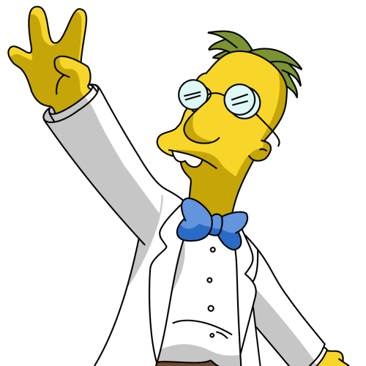
What Does it Mean to Tell a Story?
Scientific Communications Need:
Simplified Language (where possible)
A defined Big Picture Perspective
and
A Little Intrigue

Slide 11
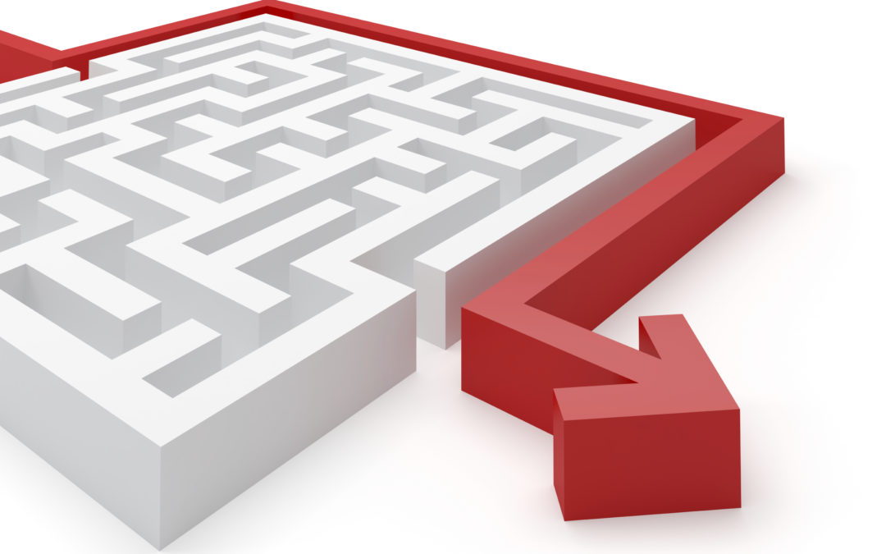
Fundamentals of Story Telling
A Story has
1. beginning, 2. middle, 3. end
Each is Distinctive
But follows some of the same rules
Logical Flow is Paramount

Slide 12
Fundamentals of Story Telling
Logical Flow:
The Story Builds from WHAT YOU KNOW
What’s known can NOT be assumed
It MUST be built along the way
Intrigue must have a FIRM FOUNDATION

Slide 13
Fundamentals of Story Telling
What’s known can NOT be assumed
This is the MAIN reason for FAILED communication
Scientists OFTEN assume that their Audience
Knows more than they REALLY do
If you are speaking to the PUBLIC → DISASTER
There is nothing worse than a PUBLIC
That thinks SCIENCE is too esoteric
And NOT MEANINGFUL in their regular lives

Slide 14
Fundamentals of Story Telling
The Story Builds from WHAT YOU KNOW
If you are writing a GRANT PROPOSAL…
Ask Yourself
Is this what you would want at a JOB Interview

Slide 15
Fundamentals of Story Telling
In the Beginning
Start with simple, plain language
You may need the Jargon, but ease into it
Define the Special Use Words
Define Abbreviations and Acronyms
As you use them

Slide 16
Fundamentals of Story Telling
In the Beginning
Introduce the characters (Ideas)
Tell what the problem is
Tell what is known so far

Slide 17
Fundamentals of Story Telling
In the Beginning of a Talk/Presentation
Delivery and Style Really Matter
A Presentation should NEVER be READ
Look the Audience in the EYE
Start with the Simplest Language
Always consider the MAKEUP of the Group

Slide 18
Fundamentals of Story Telling
Talk/Presentation
NEVER be READ
Slides should have BULLET POINTS
NOT Sentences
Sentences are not really necessary
Sentences are distracting

Slide 19
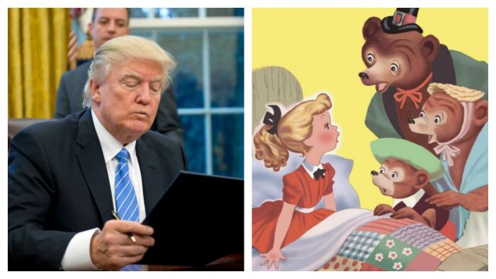
In the Beginning…
If Donald Trump
told Bedtime
Stories
Introduce the Characters
Just as you would in a Fictional Story
You can’t tell Goldilocks and the 3 Bears
Without introducing Goldilocks (or the 3 Bears)
The Characters in a Scientific Communication
Are Often Ideas

Slide 20
In the Beginning…
Characters in Scientific Communication are Ideas
But…
Built from Chemical Factors, Structural Elements, Circuits/Physical Communication, Genetics
But it is how they FUNCTION
That are the Characters of the Story

Slide 21
In the Beginning…
Tell What the Problem is
Every Scientific endeavor is Filled with Intrigue
Is a Story Interesting without some Suspense?
The Intrigue helps explain why we CARE
Explain Why the Research is Important

Slide 22
In the Beginning…
Tell What is Known So Far
This is the Firm Foundation for the Intrigue
Weave the Ideas Together as a Story
Tell What ISN’T Known
Woven Together with Rest builds the Intrigue

Slide 23
In the Beginning…
Telling Why It’s Important is Critical
What the problem is
What’s known
What isn’t known
Build the story of
Why the Research is Important

Slide 24
The Middle: Methods and Results
Tell Why the METHODS solve the problem
Connect each Result

Slide 25
The Middle: Methods and Results
Connecting Results
With the Ideas/Problem from the Beginning
With the other Results
Tell the Story of the Results
In a Logical Oder
That Logically Impels the Narrative
It is a mistake to retell results in the order of the experiments
Unless that makes the most sense

Slide 26
Methods: Advanced Techniques explained
Tell Why particular Techniques are used
Why they solve the problem
Give enough information
That the Reader/Listener knows
why these techniques solve the research problem
Do you need enough to REPEAT THE EXPERIMENT?
For Talks – NO
For Articles – Maybe
Depends on the Journal
Depends on the Experiment

Slide 27
Results: KISS
Keep it Simple
Why? Because these are the results
If the audience doesn’t understand these
You are LOST

Slide 28
Results: KISS
Data and Experimental Design determine Complexity
of the Story from here
Don’t add to it artificially
Label the Graphics as much as necessary
Keep the Figures as Simple as Possible
Figure Legends should be
straight forward and help tell the story
Results text should be straight forward
Order and Logical Flow matter

Slide 29
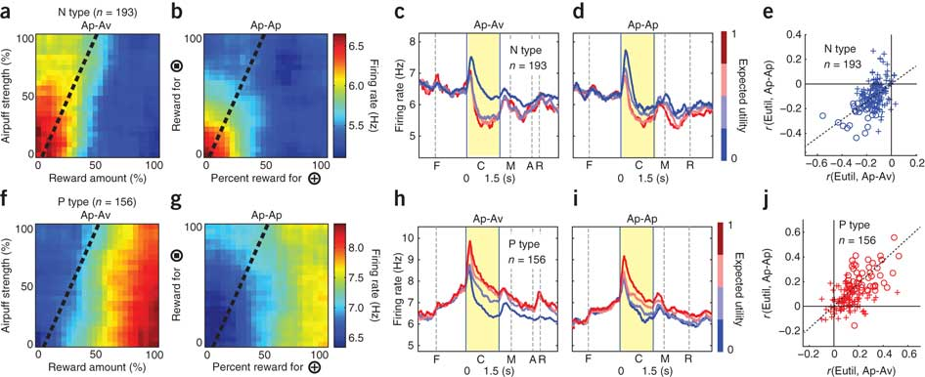
KINS (Not Keeping It Simple)
With a figure this complex, how do you know what to look at first?
This figure was generated by automated software
Does it easily tell a story?
How would a Talk audience react?
Is it all necessary?

Slide 30
KISS (Keeping It Simple)
Reconfigure
Reassess
Think about the story
With some journals you don’t have much choice
But you can still make sure it tells a story
For Talks
One Graph at a Time! (unless more tells the story better)

Slide 31
Take Home Messages
Think of your discussion
Or the End of Your Talk
Relative to the Messages
the Audience will Take Away
The Characters/Ideas + Intrigue/Problem
+ Methods-Results/Solution - Integrated
Woven together
Into the Conclusion of the Story

Slide 32
Take Home Messages
Integrated Ideas + Problem + Solution
Just like in Fiction
It should be Satisfying
The Reader or Listener should understand

Slide 33
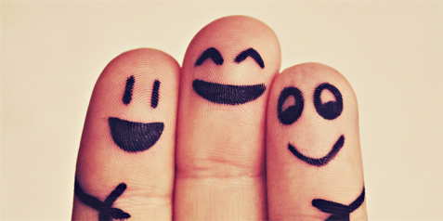
Take Home Messages
The Reader or Listener should understand
The Value of the Science
What it means for the Public
As well as for the scientific endeavor

Slide 34
My Take Home Message
Not Everyone believes that Science
is a valuable enterprise
That is our fault
We have to do a better job of communicating
With each other
And
With the public

